Slide 1
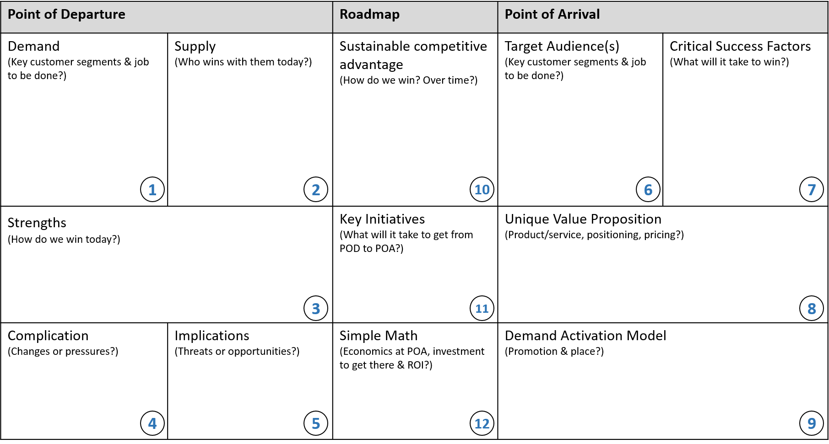
SOAP CANVAS™
© 2017, Carey F. Jaros

Slide 2
SOAP CANVAS™ COACH
Point of Departure - TODAY
POD is about getting really clear on how the market clears today – including which customers matter, who is winning and losing with them, and why – and about looking around the corner for changes that might create threats or opportunities.
Demand – who are the relevant/most valuable customer segments today and what do they need?
Supply – who’s meeting those needs now? how loyal are the customers and why/why not?
Strengths – when you win today, why? (low cost? differentiation? a proprietary asset others don’t have?)
Complication – what changes, internal or external are coming?
Implications – what threats or opportunities does this create?
Point of Arrival – THE NEAR FUTURE
POA is about imagining how demand will evolve, predicting how competitors will react, and carving out a self-reinforcing, winning position by meeting needs of customers, in ways competitors can’t or won’t.
Target audiences – which customers will have the most financial &/or strategic value in the future?
Critical success factors – what will matter most to them? (low cost? differentiation? access to an asset?)
Unique value proposition – what of value can you offer that others can’t or won’t?
Demand activation model – how will you create awareness, conversion, and loyalty?
Roadmap – GETTING FROM HERE TO THERE
Roadmap is about how to get from POD to a place of sustainable competitive advantage – the 3-5 most critical initiatives that stand between your business today and the value prop and demand activation model you’ll need to win tomorrow.
Sustainable competitive advantage – at POA, how can you use every customer win to create more distance from competition
Key initiatives – what are the most essential pieces of work to transform your offering from POD to POA
Simple math – is the ongoing operating model reasonable, and is the return on any investment attractive enough
© 2017, Carey F. Jaros

